Slide 1

Predicting Stock Market with Machine Learning & Python
A Case Study on Tata Motors
Abhishek Anand Katare
PRN – 23050209103
BATCH: 2023 - 2025
Dr. D. Y. PATIL VIDYAPEETH, PUNE
CENTRE FOR ONLINE LEARNING

Slide 2

Executive Summary
Market prediction is complex due to non-linearity and external influences
Built a hybrid model using ML + Sentiment Analysis
Case study: Tata Motors (NSE: TATAMOTORS)
Tools: Python, yfinance, scikit-learn, NLTK, Transformers
Model Architecture: Random Forest Classifier with engineered features (ratios & trends)
Includes backtesting framework and real-time sentiment scraping
Final model precision: ~0.66 (↑ from 0.57)

Slide 3

Problem Statement & Objectives
🔶 Problem:
Traditional forecasting struggles to process vast volumes of unstructured data (e.g., news, social sentiment).It often lacks timeliness, objectivity, and adaptability to market psychology.
✅ Objectives:
Predict next-day stock direction (Up/Down) for Tata Motors.
Engineer technical indicators (ratios, trend counts) to improve model performance.
Integrate sentiment analysis from news headlines using VADER & RoBERTa.
Evaluate model with precision score and visual validation (actual vs predicted).
Build a backtesting framework for real-world trading simulation.

Slide 4

Methodology Overview
📌 Data Sources: Yahoo Finance, Economic Times, & NewsAPI.
🤖 ML Model: Random Forest Classifier, Baseline, & Enhanced
💬 Sentiment Engines: VADER (rule-based), RoBERTa (transformer)
📊 Evaluation: Precision Score, Backtesting, & Visual Plots.
Notes:
Data Sources:
Quantitative:
Yahoo Finance (OHLCV: Open, High, Low, Close, Volume)
Qualitative
News headlines via Economic Times (web scraping) & NewsAPI.
ML Model
Random Forest Classifier (Robust to noise, interpretable, fast)
Baseline: Raw OHVCL features
Enhanced: Rolling ratios + trend features
Sentiment Engines:
VADER: Rule-based sentiment scoring (fast, interpretable)
RoBERTa: Transformer model for context-aware, aspect-level sentiment.
Evaluation
Metric: Precision Score (better than accuracy for imbalanced data)
Validation: Rolling window backtesting to simulate real-time forecasting
Visualization: Actual vs Predicted movement, Sentiment vs Price overlay

Slide 5
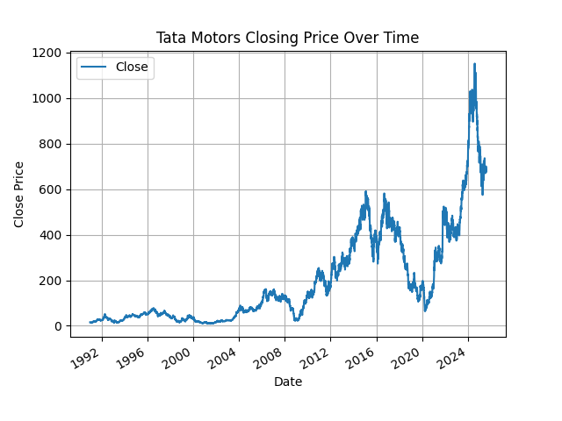
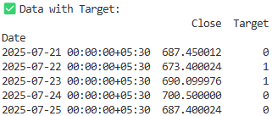
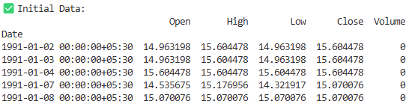
Data Collection & Preprocessing
📈 Quantitative
~5000 OHLCV records from Yahoo Finance
📰 Qualitative
100+ financial headlines scraped from Economic Times
Supplemented with NewsAPI for recent and historical sentiment analysis
Headlines mapped to dates to align with stock movement
⚙️ Transformations
Feature engineering (ratios, trends)
Target Creation: Binary label indicating next-day movement (1 = up, 0 = down)
Cleaning: Dropped missing values, removed non-informative columns

Slide 6
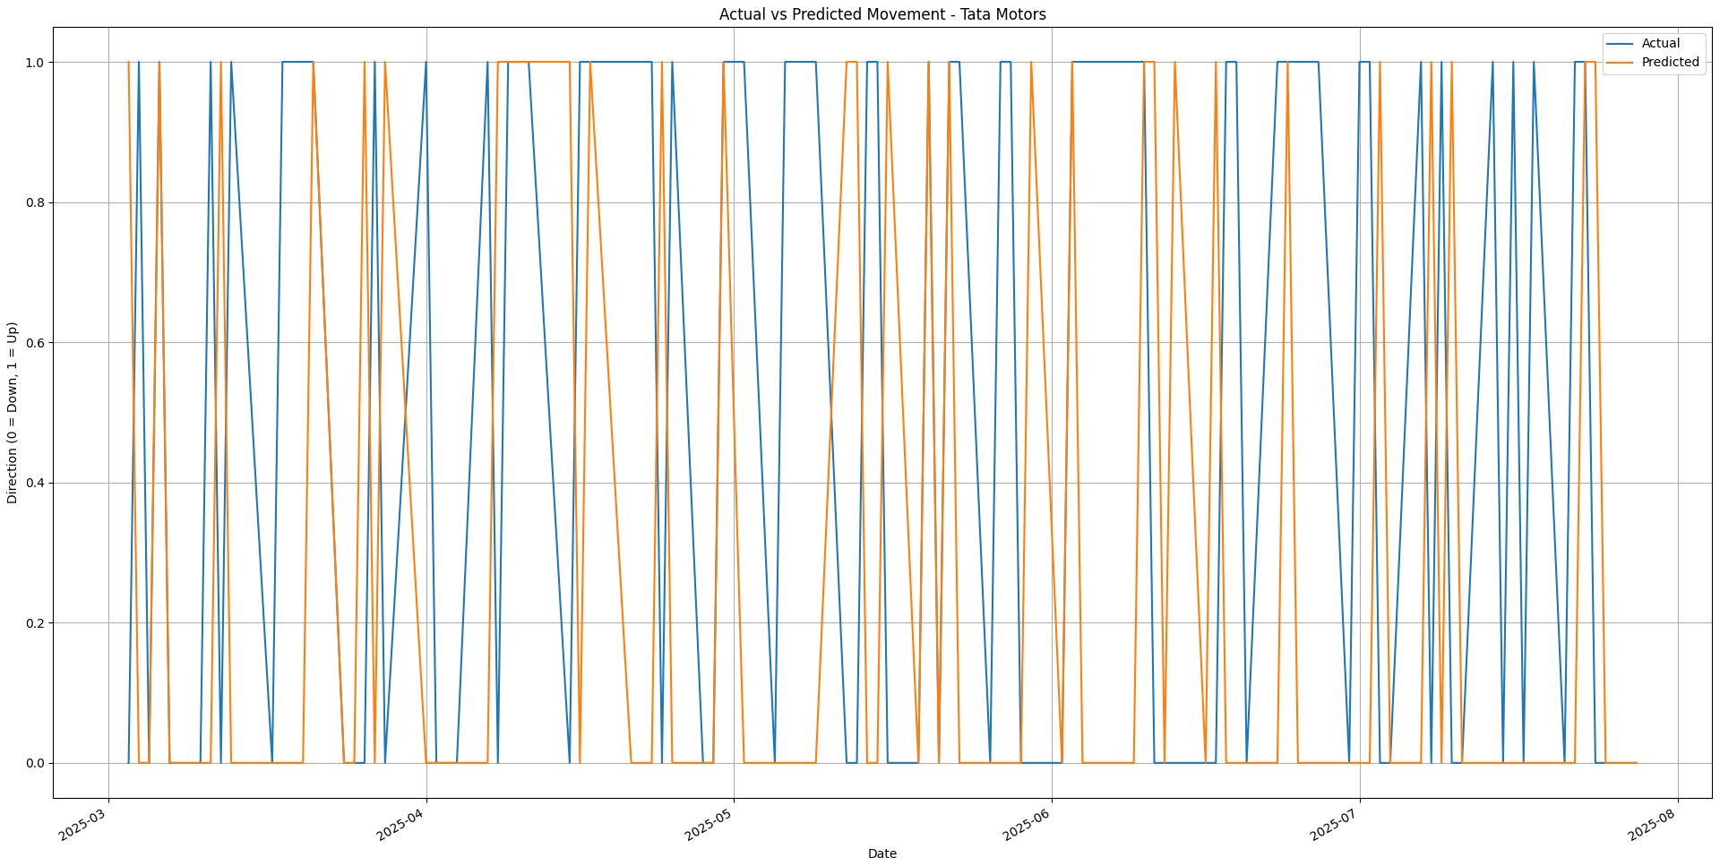
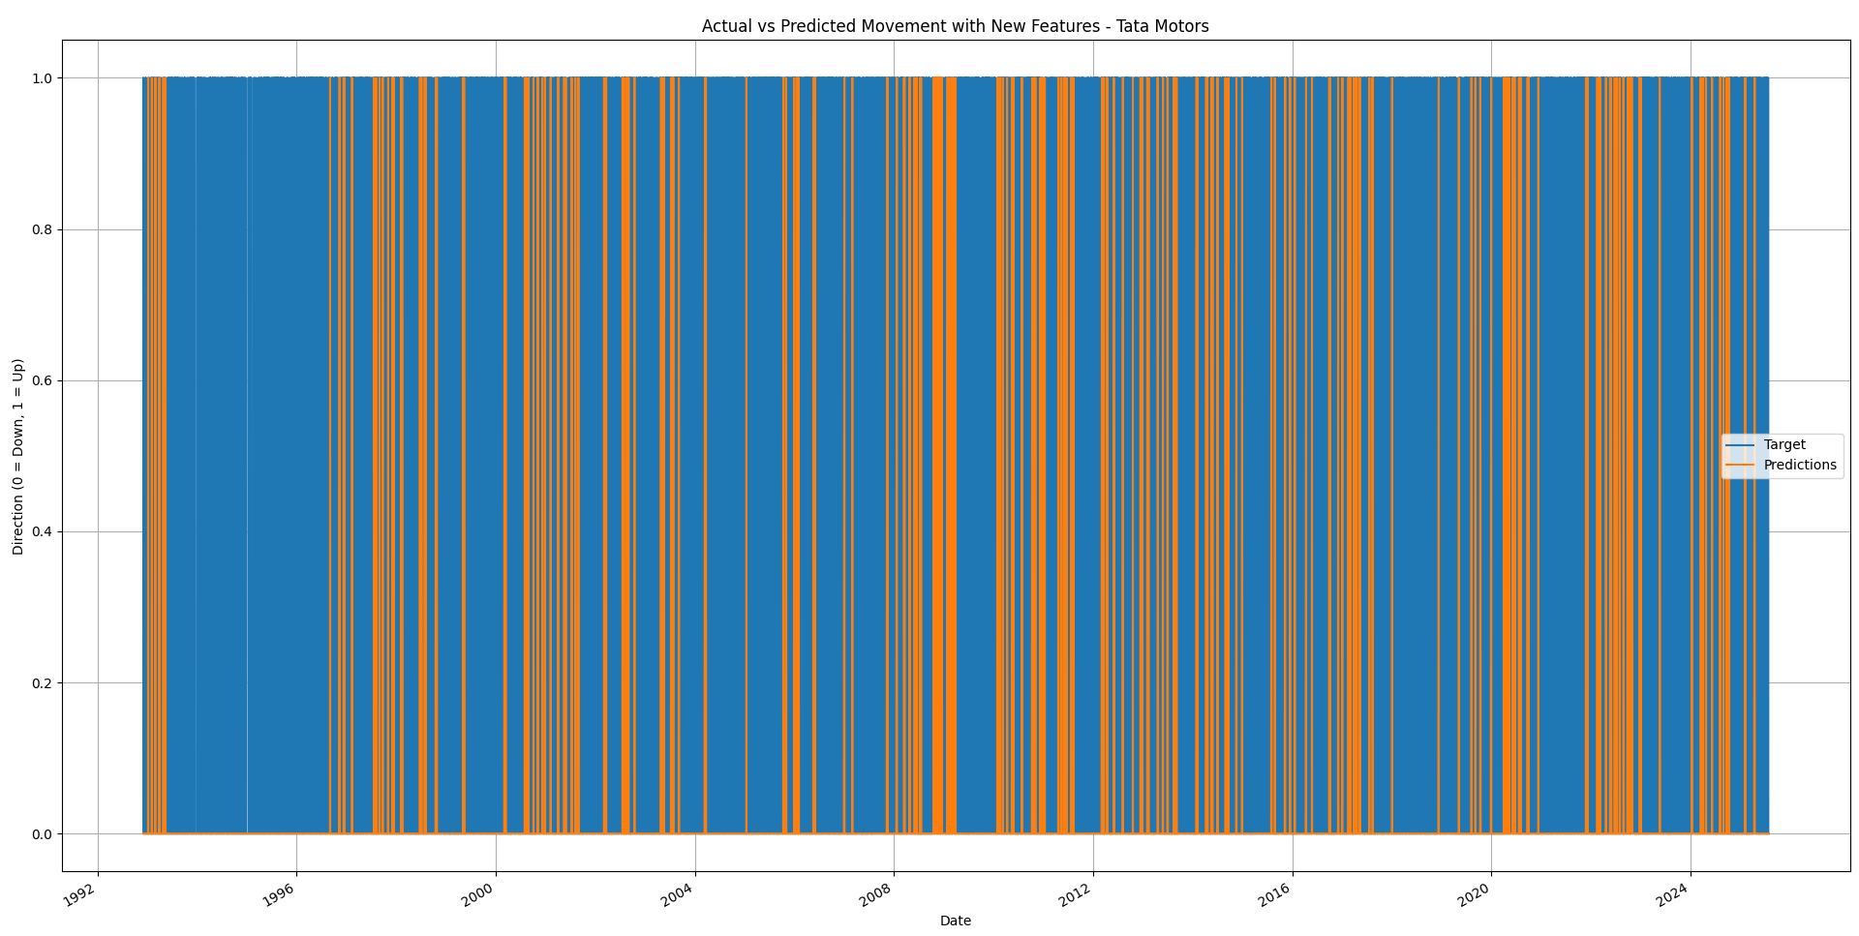
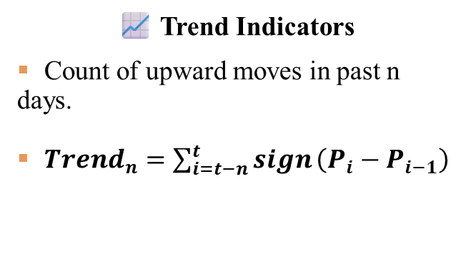
Feature Engineering
⚙️ Rolling Averages
Rolling averages (2, 5, 20, 60, 250-day windows)
Close Ratios & Trend indicators.
📈 Trend Indicators
Count of upward moves in past n days.
${Trend}_{n}=\sum_{i=t−n}^{t}{sign}\left(P_{i}−P_{i−1}\right)$
Notes:
Close Price Ratios:
For time horizons of 2, 5, 20, 60, and 250 days.
Example: Close_Ratio_5 = Close / Rolling_Mean_Close_5
Trend Features:
Sum of recent 'up' movements over respective horizons.
Example: Trend_20 = Sum of Target (past 20 days)

Slide 7
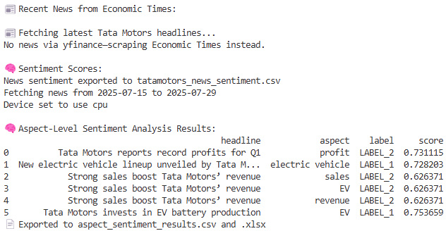
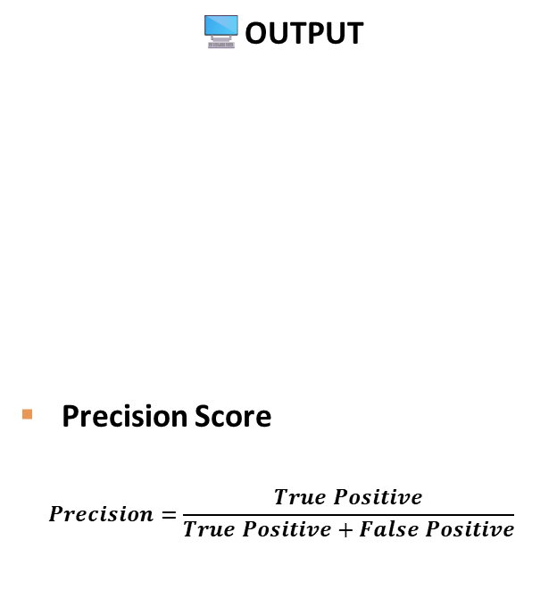
Sentiment Analysis
🧠 VADER (Rule-Based)
Classifies sentiment using compound scores.
VADER Sentiment Scores (Top 3 Headlines)
🤖 RoBERTa (Transformer-Based)
Deeper NLP for aspect-level sentiment (EVs, profits, etc.).
RoBERTa Aspect-Level Sentiment
🖥️OUTPUT
Precision Score
$$Precision=\frac{True Positive}{True Positive+False Positive}$$
Headline | Compound Score | Sentiment
Tata Motors reports record profits for Q1 | +0.78 | 👍 Positive
Tata Motors stock drops after global chip shortage | -0.62 | 👎 Negative
New EV lineup unveiled by Tata Motors | +0.65 | 👍 Positive
Headline | Aspect | Label | Score
Tata Motors reports record profits for Q1 | profit | POSITIVE | 0.99
Strong sales boost Tata Motors’ revenue | sales | POSITIVE | 0.96
Tata Motors faces chip shortage | shortage | NEGATIVE | 0.94
Notes:
Using VADER (Rule-Based)
Applied to each headline to extract compound sentiment score.
Sentiment classified as:
+0.05: Positive
< -0.05: Negative
Else: Neutral
Using RoBERTa (Transformer-Based)
Pre-trained twitter-roberta-base-sentiment used for advanced contextual sentiment.
Mapped keywords like "EV", "profit", "investment" to corresponding sentiment labels.

Slide 8
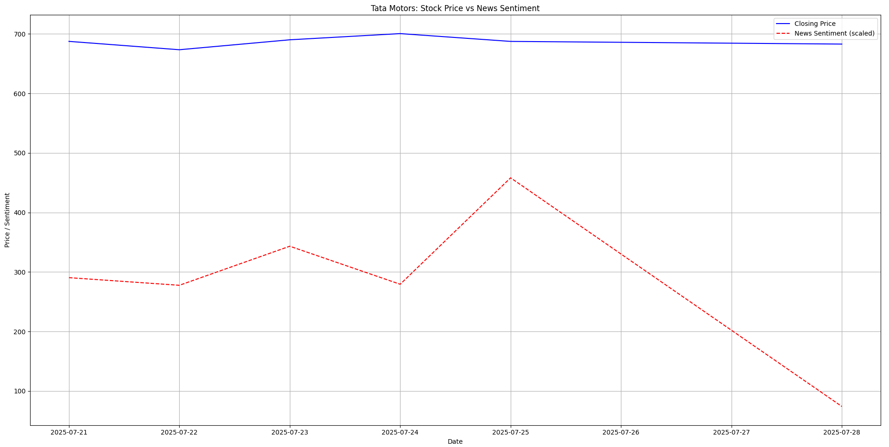
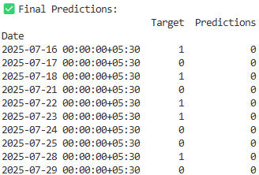
Sentiment Analysis
📊 Sentiment-Price Correlation
Merged sentiment scores with stock prices
Identify patterns between news tone and price movement
Sentiment used as additional predictive feature

Slide 9


Model Results
Final model achieved ~0.66 precision, outperforming baseline by ~9%
MODEL | FEATURES USED | SENTIMENT | PRECISION
🎯Baseline | OHLCV only |  | ~0.57
🎯Enhanced | OHLCV + Trends |  | ~0.63
🎯Final | OHCVL + Trends + Sentiment |  | ~0.66
⚙️ Threshold Tuning:
Custom threshold (≥ 0.6) reduced false positives
Improved prediction confidence and precision
💬 Sentiment Integration:
News-based sentiment features enhanced model’s understanding of market psychology
Strong correlation with price movement patterns

Slide 10

Limitations & Future Scope
⚠️ Limitations:
Focused on a single stock (Tata Motors)
Daily-level prediction (no intraday insights)
Not deployed for real-time forecasting
🚀 Future Enhancements:
Use LSTM / Transformer models for time-series learning
Extend to multiple stocks and intraday predictions
Build a live dashboard with real-time alerts & sentiment tracking

Slide 11
Conclusion
📌 Summary
Built a hybrid ML model combining technical indicators and news sentiment
Demonstrated effectiveness using Tata Motors case study
Achieved ~0.66 precision, up from ~0.57 (baseline)
📈 Key Learnings
Feature engineering boosts model performance
Sentiment signals add real-world context to predictions
Backtesting ensures realistic model validation
🔮 What’s Next?
📊 Add more stocks & sectors
⏱️ Use intraday/tick-level data
🤖 Explore deep learning (LSTM, Transformer forecasting)
🧾 Integrate macroeconomic indicators
📡 Deploy real-time dashboard + alert system
🧠 Impact
Provides a blueprint for algorithmic trading, decision support, and financial analytics

Slide 12

THANK YOU
Abhishek Anand Katare
PRN – 23050209103
BATCH: 2023 - 2025
Dr. D. Y. PATIL VIDYAPEETH, PUNE
CENTRE FOR ONLINE LEARNING

